Slide 1
Online Retail Store

Slide 2
Introduction
The Online Retail Store has been performing well and the management wants to analyze the major contributing factors that impacts the revenue.
Management also intends to expand the business and is interested in seeking guidance into areas that are performing well.

Slide 3
Main KPIs
Revenue by Year
Revenue for the Year 2011(Month-wise)
Revenue by Quarter(Year 2011)
Top 10 countries generating Revenue
Top 10 customers
Demand-wise Countries

Slide 4
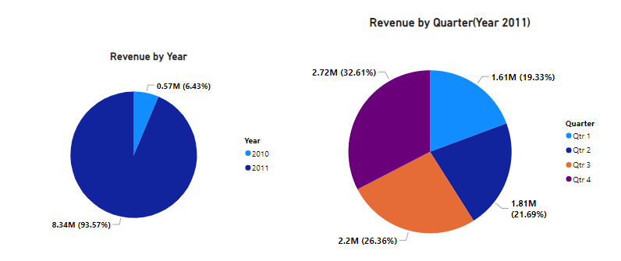
Online Retail Analysis

Slide 5
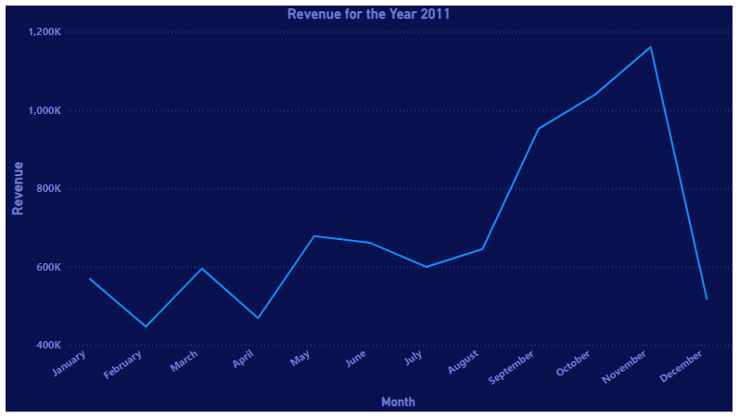
Online Retail Analysis

Slide 6
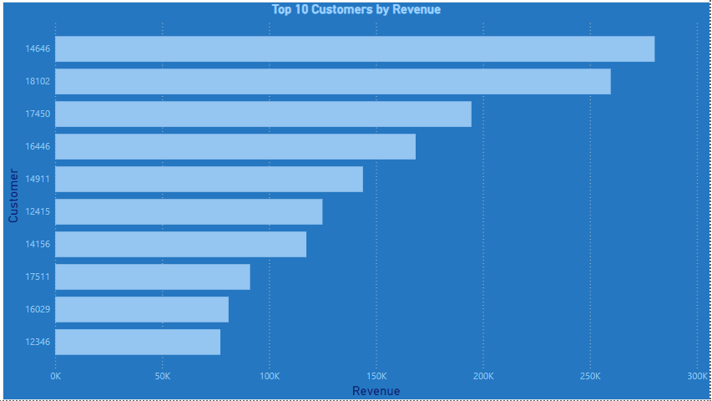
Online Retail Analysis

Slide 7
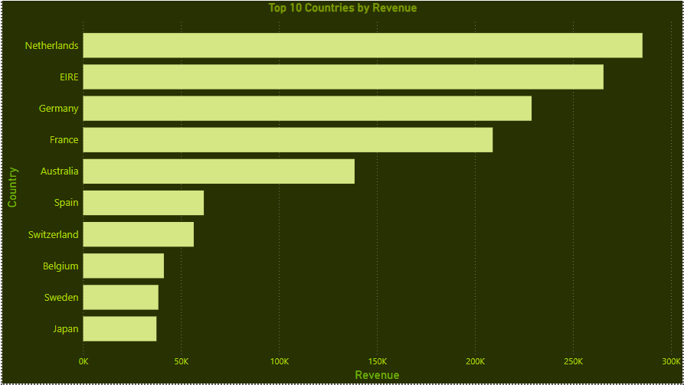
Online Retail Analysis

Slide 8
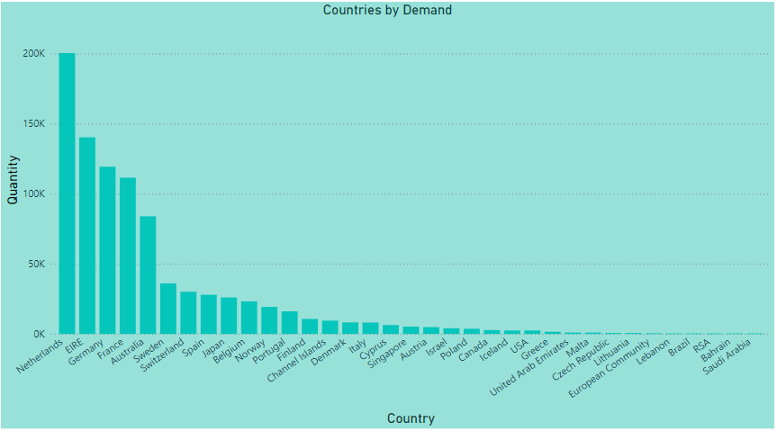
Online Retail Analysis

Slide 9
Thank You

